Slide 1
WELL CENSUS National Hydrology Project Kerala Groundwater
5th World Bank Mission
at Bengaluru

Slide 2
Well Census - Objective
Collecting physical number of actual groundwater abstraction structures and realistic draft figures for various domestic, irrigation, industrial purpose for evolving groundwater budgeting of Kerala State.
In addition to this several other data are also collected, which will help in more reliable inferences on the groundwater availability, ie, amount of extraction, knowledge about water scarce area, groundwater quality, thickness of the phreatic horizon, bedrock profile etc. This information will help immensely in future for the sustainable development and management of groundwater resource.
Department intends to collect the data of all ground water extracting structures like open wells, bore wells, tube wells, filter point wells, Surangans, ponds, springs etc.

Slide 3
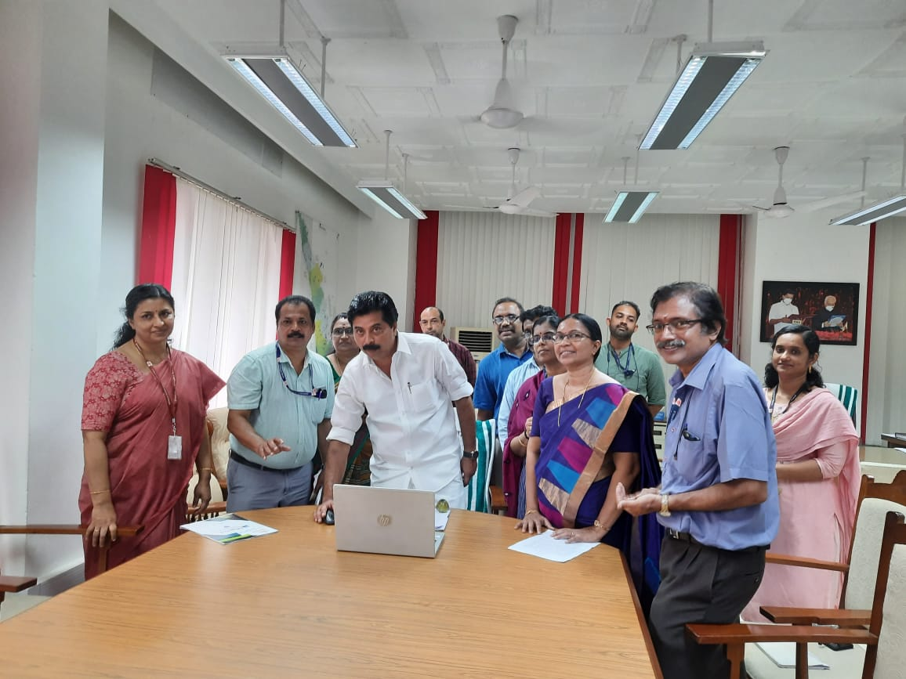
Proceedure
Well Census - Data collection
The entire data collection is in digital format and an Android application, “ Neerarivu” is developed with the help of Kerala State Remote Sensing and Environment Center (KSREC) for data collection.
Several modifications were incorporated in the app after a series of discussions for making the app simple, user friendly and informative.
The app also support local language.
“Neerarivu” is inaugurated by Sri. Roshi Augustin,
Hon’ble Minister for Water Resources, Kerala
“Neerarivu” app training given to Department officials
by KSREC

Slide 4
“Neerarivu”

Slide 5
“Neerarivu”

Slide 6
“Neerarivu”

Slide 7
“Neerarivu”

Slide 8
“Neerarivu”

Slide 9
“Neerarivu”

Slide 10
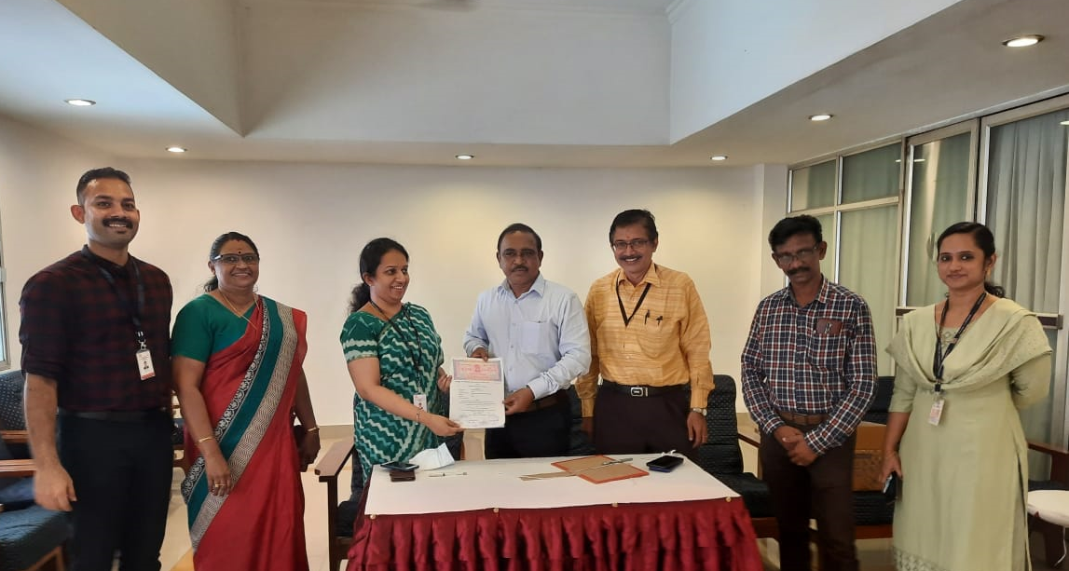
Well Census-Consultancy
State Women Empowerment Organization ( Kudumbasree Mission) is selected as consultant Organization for data collection.
Pilot Study was conducted in 9 wards of 9 Districts in Kerala using the mob app “Neerarivu” and proposal submitted with a rate of Rs. 32.5 per structure in plain area and Rs. 52.5 per structure in hilly area. MoWR has accepted the proposal
Well Census data collection is scheduled as 2 phases. In the Ist phase, Over exploited, Critical and Semi Critical blocks of Kerala are selected and Rs. 600 Lakh has been sanctioned for Ist phase for data collection in 39 blocks . In the IIst phase 49 safe blocks are selected for Rs. 800Lakh.
Agreement execution by Sri. John V Samuel IAS, Director, GWD & Sreedevi IAS, Executive Director, Kudumbasree

Slide 11
Well Census-Data collection
Training on Well Census data collection has been given to 105 Supervisors of Kudumbasree by the officials of Ground Water Department.
Training of 1215 enumerators who were selected by Kudumbasree for field level data collection has been given by Supervisors of Kudumbasree Mission
To ensure the quality of data, random verification will be done by the district officials.
For clearing the issues raised during data collection, whats app group was created under each supervisors and doubt clearance is being done by Department officials and mobile app developer team
Training given to Kudumbasree members by Department officials

Slide 12
Well Census- Data collection- Proceedures
Implementation by Groundwater Department
Neerarivu – KSREC,
Consultancy-Kudumbasree
ToTs give training to Kudumbasree Supervisors in their district
Data received in Server, verified by Groundwater Department
Enumerators collect well census field data
Training given to
Department officials in all Districts (ToTs)
Kudumbasree Supervisors give training to Enumerators

Slide 13
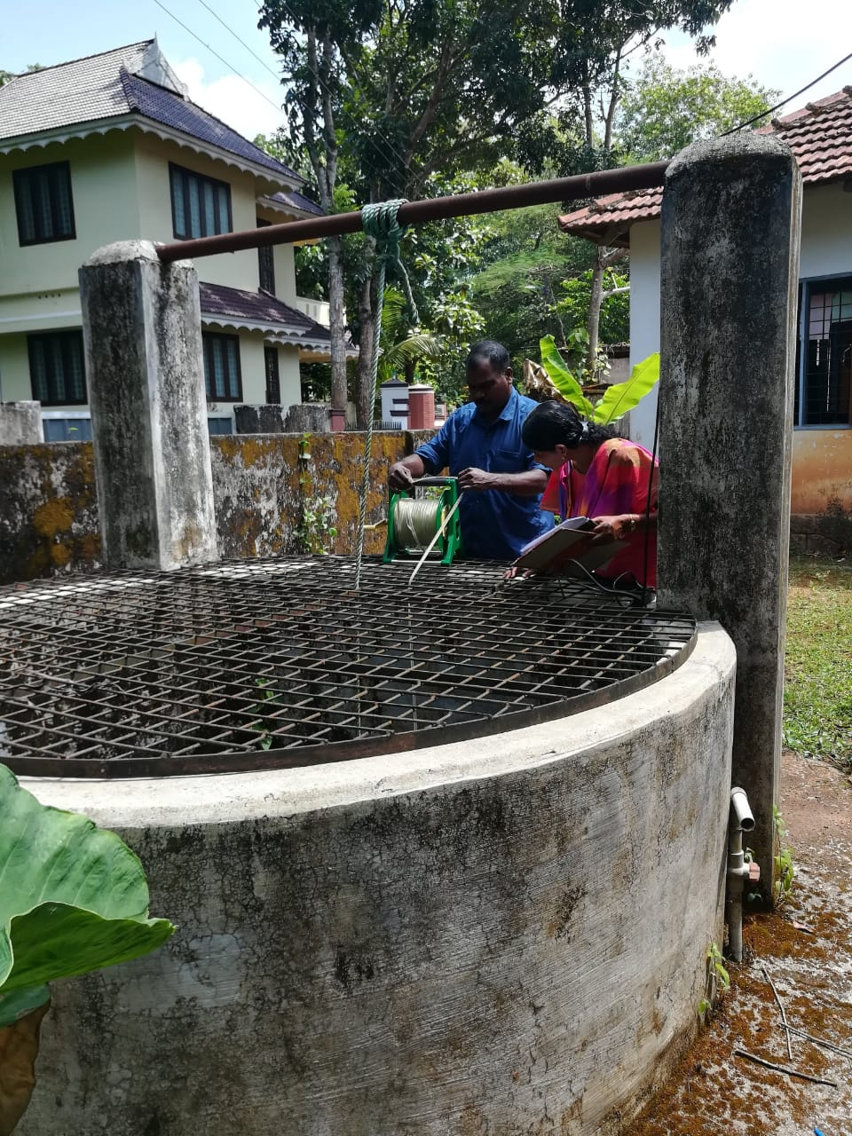
Well Census-Output
The ultimate output expected is the Water Budgeting System, i.e. a single window solution for comprehensive, authoritative and consistent data and information of water resources in a standardized GIS frame work for water resource management in watershed level and also in administrative level
Evolved data base can be used as a aid for drought prediction and drought control and also can be used for flood mitigation works.
The data base is a major supporting document for the augmentation of groundwater by implementing cite specific artificial recharge measures.

Slide 14
THANKS

